Slide 1

COMP47250: Team Software Project
PRESENTATION 4
6th JULY, 2020

Slide 2

Team Rocket
Aditya Krishnan 15316048
Apurva Deore 19200283
Ashwin Manikandan 19201000
Minaz Shaikh 19200200
Nripendra Singh 19200326
Sumit Kumar 19200701
Vishal Padma 19200174

Slide 3






Project objectives
Challenge 1: COVID-19
COVID-19 INTERACTIVE VISUALIZER

Slide 4
AIM Creation of a Web-based Chatbot Application and Map Visualizer which would enable us to solve user queries regarding the COVID-19 pandemic across the world. We aim to create more awareness among people regarding the effects of the pandemic specifically in the health sector, i.e Infected rates, Death rates, Recovery rates, etc, by letting users directly interact with the chatbot. The web page will use trusted sources to gather relevant information in the aforementioned categories which will be used to drive the responses of the bot and power the map based visualizations of the world which will be also deployed on the same application.
We plan to achieve two paramount features
CHATBOT
A chatbot which would answer user’s queries about COVID-19.
Eg: Symptoms of COVID-19?
INTERACTIVE MAP
An interactive map-based feature deploying visualizations that provide statistics about COVID-19 of various countries.
E.g. Total cases? Active cases?

Slide 5
Project Plan
After having achieved partial V1.2, lacking the integration of the chatbot with the front end pf the application, we aim to further breakdown tasks and reach goals into sprints and release versions. As part of the main non-trivial extension we would like to first refine the scope of the chatbot to being strictly restricted to information regarding Ireland.
Version 2.1 (14th July – 20th July’20)
Refining the functionality of the application to better improve User Experience and integration of the chatbot to the existing web application, With finer implantation of previous work done.
Version 2.2 (21st July – 28th July’20) 🡪 Milestone 2/Final Product
Final core implementations and refinement of the paramount tasks (House the Chat-Bot and prepare the map visualizations) before the deployment of the application for user testing and evaluation and subsequent preparation of the final report.
Version 2.3 (29th July – 3rd August20) 🡪 Evaluation and refinement of the Final Product
Run evaluation framework on the application based on User based functionality tests and assessment forms to ensure the application is functioning as expected. fore the final deployment of the application for subsequent preparation of the final report the feedback will be used to further improve the application.

Slide 6
Roles
Aditya and Minaz (Front-End Team) Decide on the UI design and layout and functionality of the Webpage with the subsequent creation of Front-End.
Integration of the Front-End with the Back-End. Refine the Web page with improved functionality to help better the UX
Apurva and Vishal (Data and Visualization Team) Research on the second potential API required and write scripts for Data Collection.
Data Mining and Data Cleaning/Pre-processing as and when required.
NLP Processing for Text and research/deploy visualizations.
Ashwin (Cloud Deployment Team) Test/Deploy the required resources (Data Lake/ PostgreSQL/Data Factory/DB).
Create dummy scripts and trigger them using data factory pipelines.
Research on how to connect PostgreSQL to Front-end.
Sumit and Nripendra (Django Team)
Analyze for the risks involved and prepare .Net Backup
Prepare the structure of Lex API, and develop intents based on user requirements.
Creation of Back-End and integration with the front-end.

Slide 7
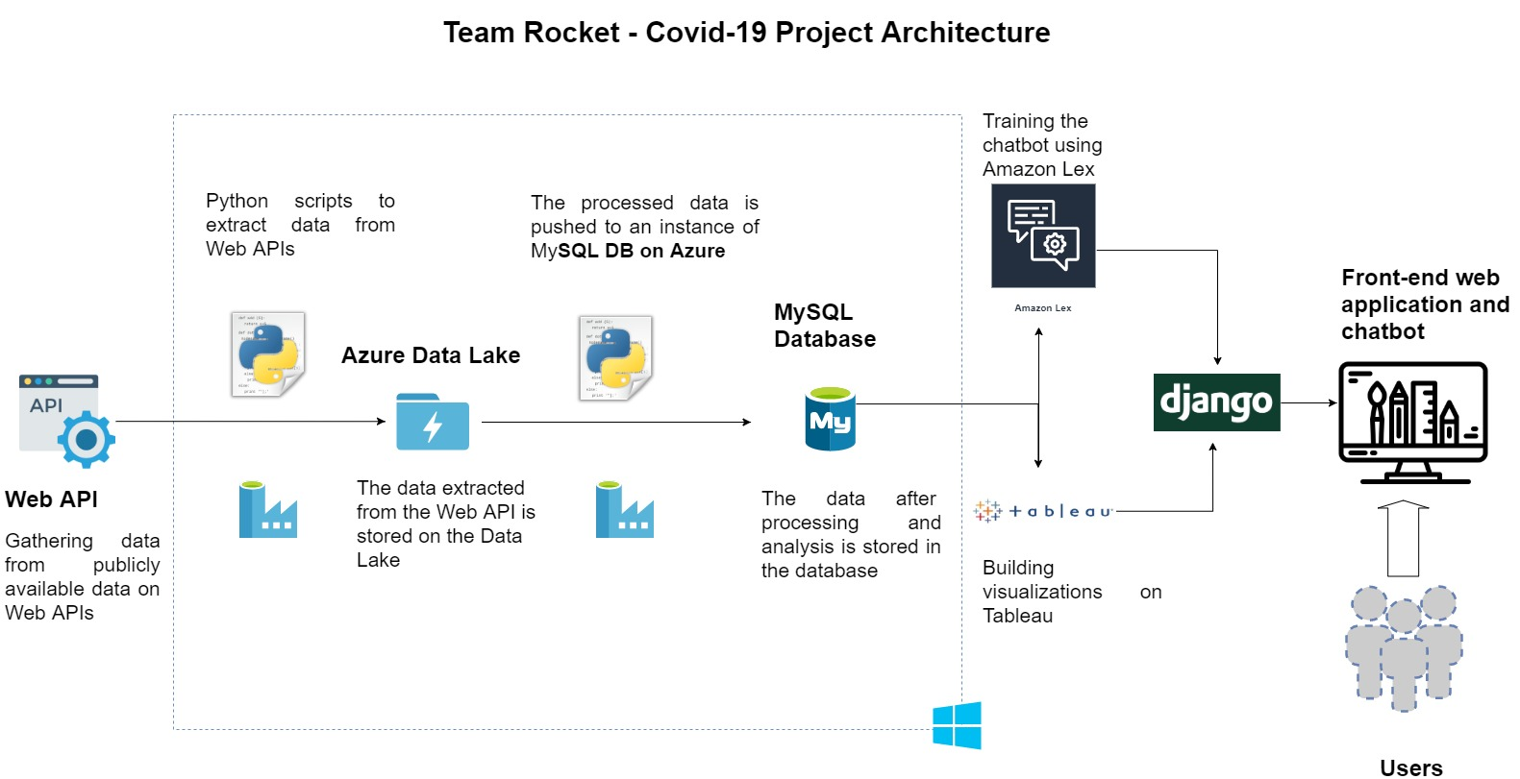
Architecture

Slide 8
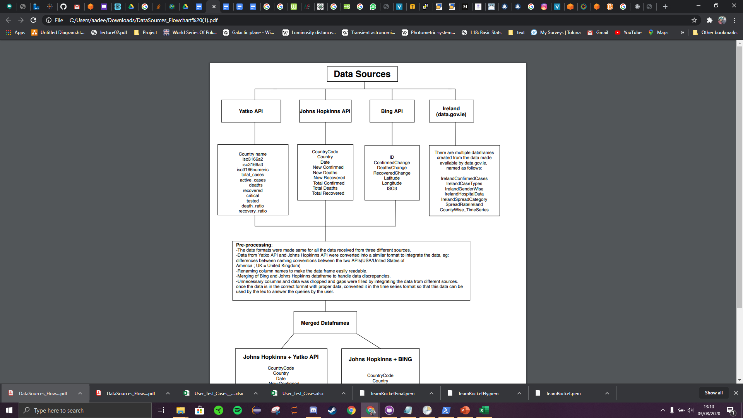
DATA PLAN

Slide 9
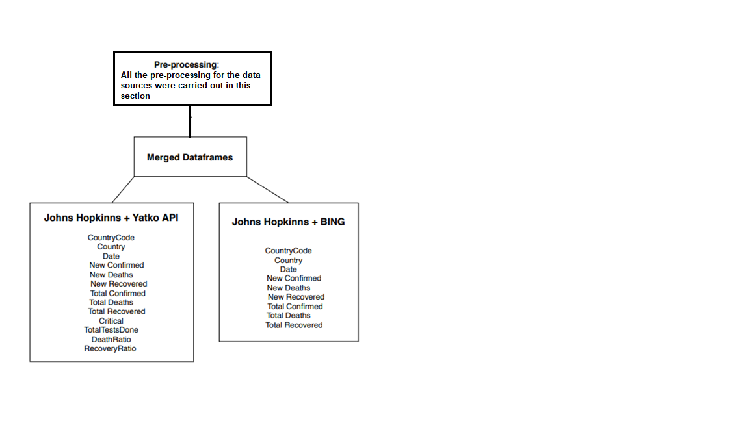
DATA PLAN

Slide 10
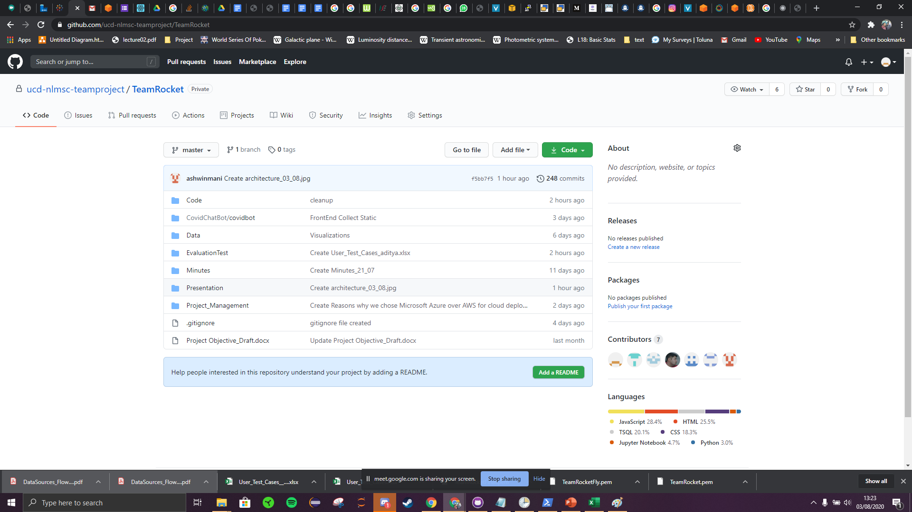
GitHub
Work done until now; like ideas proposed, minutes of meetings, any research done so far related to the project, has been pushed onto our team’s repository.
We’ve created different folders and are constantly push-committing the work as and when it is completed.
Just to give a gist…

Slide 11
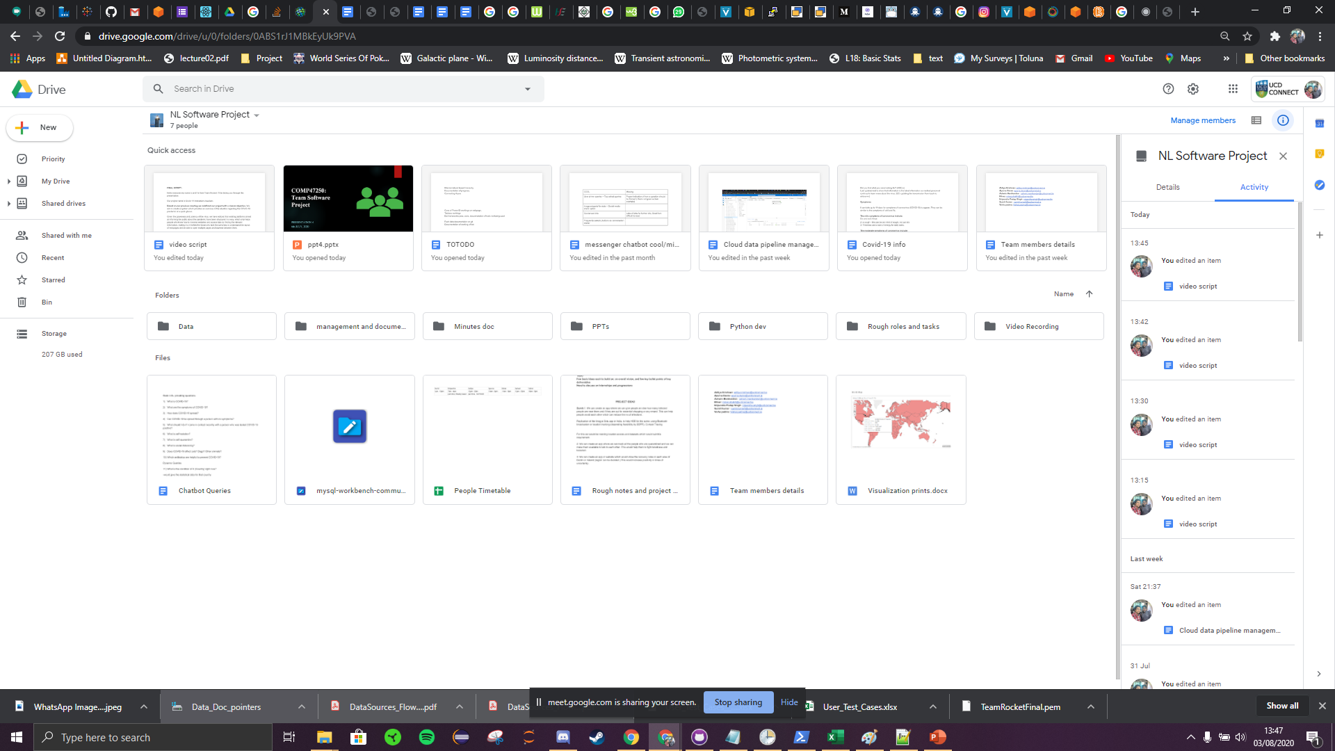
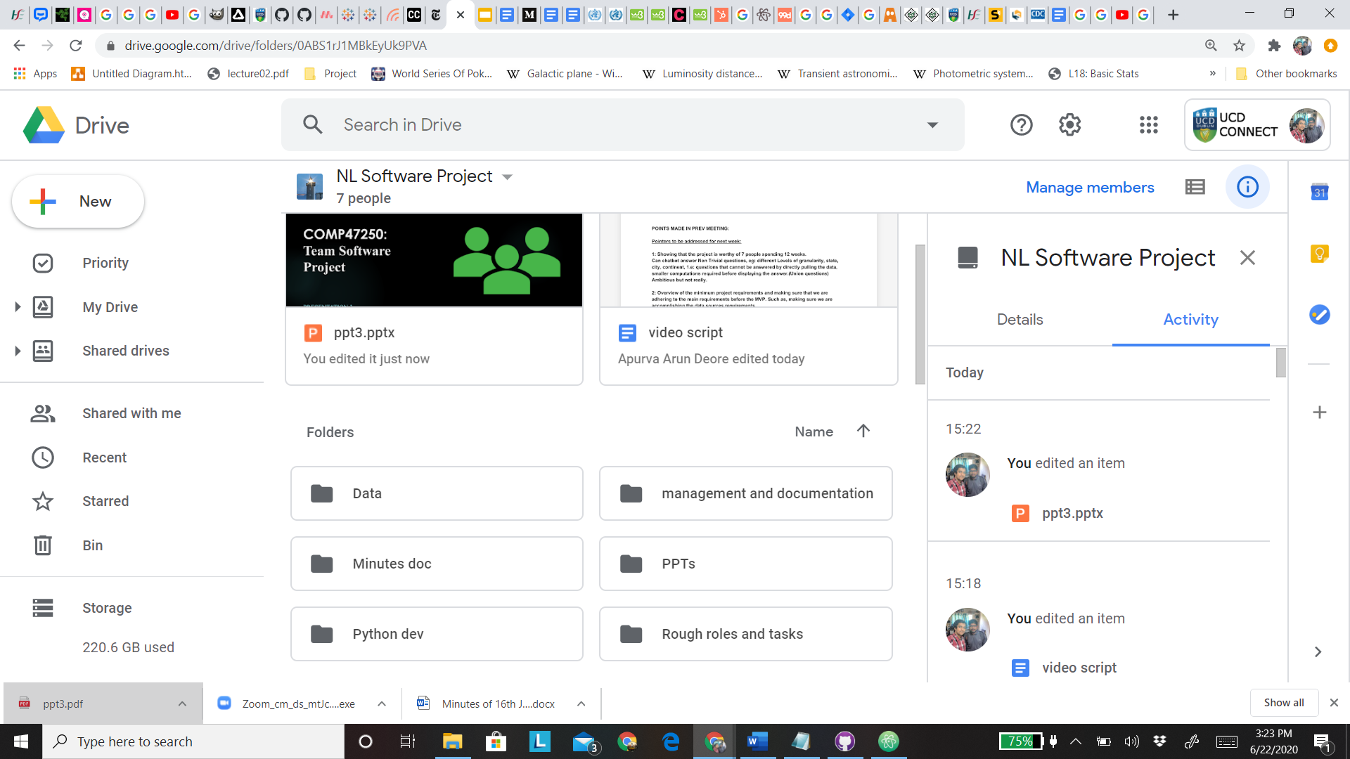
Team Management
Team progress managed by Sumit and Aditya:
Shared google drive folder which contains all the different folders for each team consisting of basically all of the data cumulated at one place for enhanced availability and accessibility, including the log of each MOM and documenting the progress of the team at each stage.
Conducting daily meetings via Google Meet and logging MOM of each meeting
We’re using Jira to outline each team member’s work, define sprints, plan the work to be done and the corresponding deadlines for them.
Just to give you a gist, you can see on the right; our Jira board with tasks allocated and our shared folder on Google Drive.

Slide 12
Progress So Far..
Front-End
Clean the front-end of the web application design and structuring the layout of the pages accordingly.
Addition of new visualizations to further focus on the scope of the project
Adding functionality to the overall usability of the web-page to better help the user experience.
Researching potential features for better UX
Data
Scripts written for the collection of raw data from the desired sources (CSV format).
Integration of the summary data from both the API and the final merged Dataset set for each country which will be later used in the visualization.
Preparation of new visualizations to be embedded into the front end of the application.
Dealt with data discrepancies
Test Evaluation Scripts
Creation of a User Test Case script template and a peer review template using google forms.
Identification of the scope of the bot and the collection of Amazon lex metrics to evaluate the performance of the chatbot.

Slide 13
Cloud Architecture
Created basic pipelines to connect new Ireland specific data file systems with the data lake.
Creating dummy scripts and triggering them using data factory pipelines.
Finalised on using Azure as the primary cloud platform given the ease of use of the platform.
Django Framework
Review LEX API, to identify constraints and capabilities in full
Reorganise the structure to narrow the scope of the queries that is aimed to be fulfilled.
Deployed the application from start to finish on an AWS EC2 instance.

Slide 14
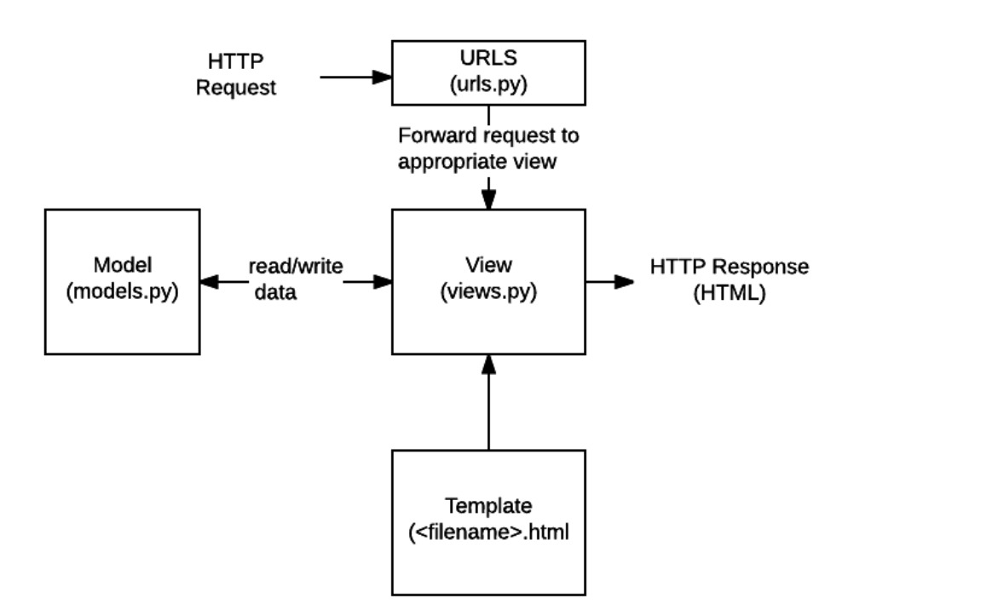
Django framework

Slide 15
Evaluation of the Application.
Carried out two core evaluation methods for the project
Built scenario wise, user-based test cases to test the overall functionality of the webpage with different users and different platforms.
Online survey based assessment and feedback forms using Google Forms: Used to monitor the ease of use of the application for users of different types.
We are reviewing the feedback received and accordingly make changes to make sure the application is more intuitive and is able to function better in regards to the overall user experience.

Slide 16
Web Request
Django backend
Website
Web Design
CSS Libraries 1.Bootstrap. 2. w3school 3.etc
JS Libraries for responsive design 1.Bootstrap bundle.
2. Jquery for animation.

Slide 17
STAY SAFE!
THANK YOU!
-Team Rocket

